Slide 1
Understanding the mode
Numerical summaries of data

Slide 2
how to use Oak lessons

Slide 3
I can understand what the mode is measuring, how it is measuring it and find the mode from data presented in a list.

Slide 4
mode
bimodal
trimodal

Slide 5
The mode is a measure of central tendency or average. It is the most common value or class with the largest frequency. Some data has no mode or more than one mode.
Sets of data which have two modes are known as bimodal data.
Trimodal data has three modes.

Slide 6

Understanding the mode
Finding a mode
It is not always one mode

Slide 7

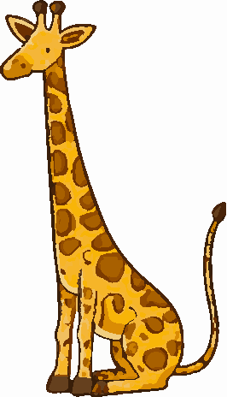
Finding a mode
Which animal appears the most?
elephant

Slide 8
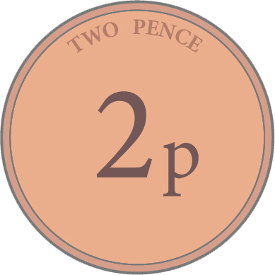
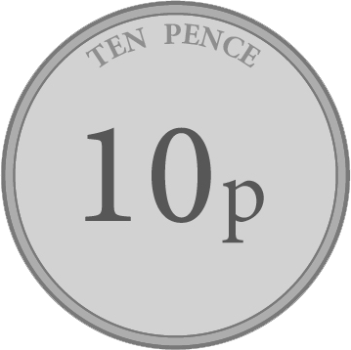
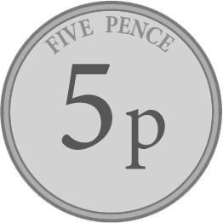
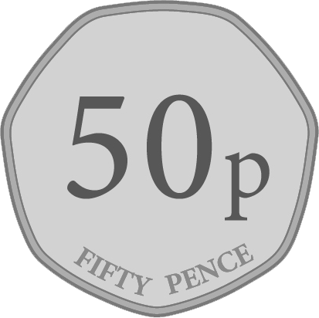
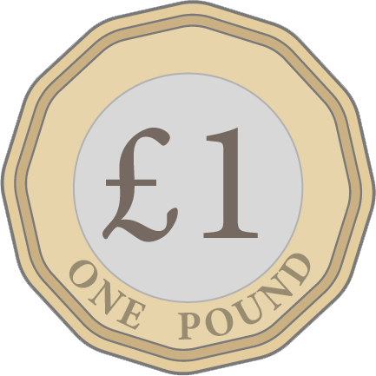
Finding a mode
Lucas empties his wallet. Which coin does he have most of?
5p coin

Slide 9
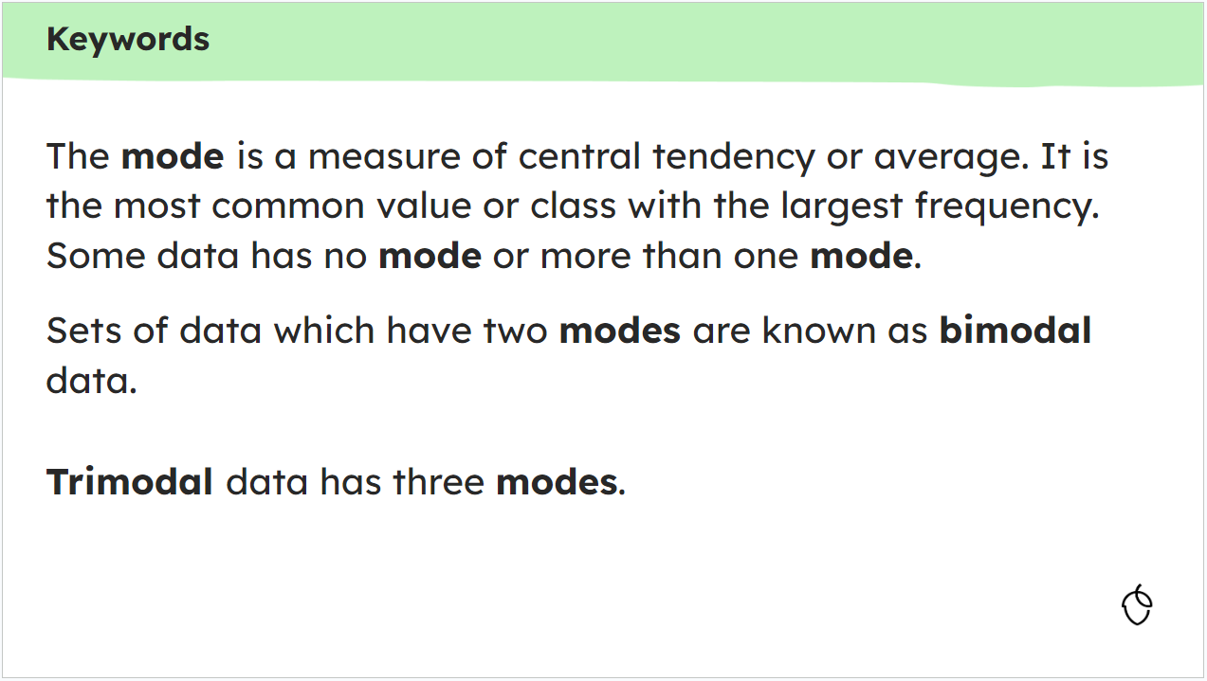
Finding a mode
Which letter appears the most on the keywords slide?
e - 28 times

Slide 10
Finding a mode
Elephant, 5p coin and ‘e’ were the modes of the data.
They were identifiable by looking for the ‘thing’ that appeared the most compared to the other ‘things’.

Slide 11

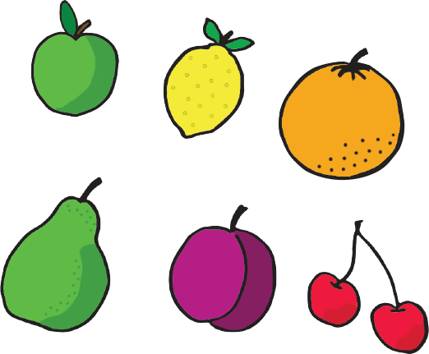

Finding a mode
What is the modal fruit?

Slide 12
Finding a mode
What is the modal fruit?
The lemon

Slide 13
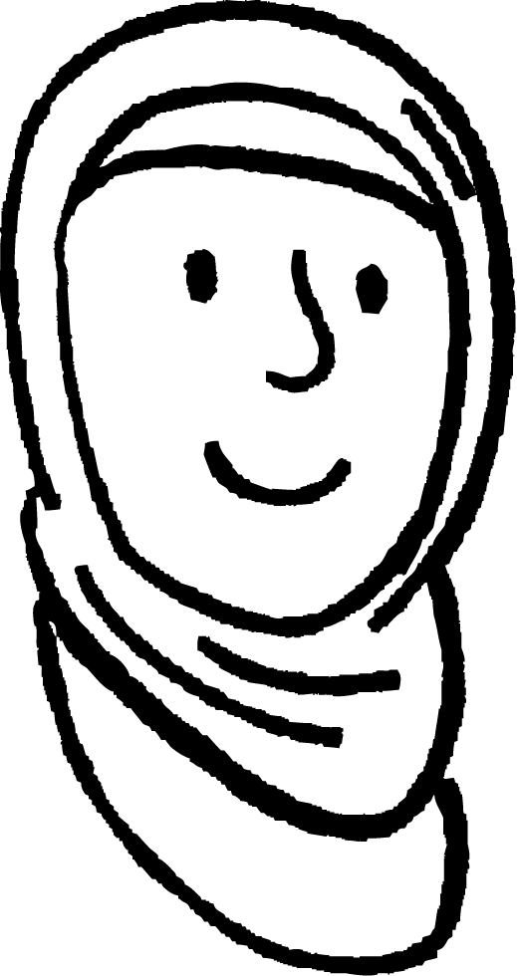
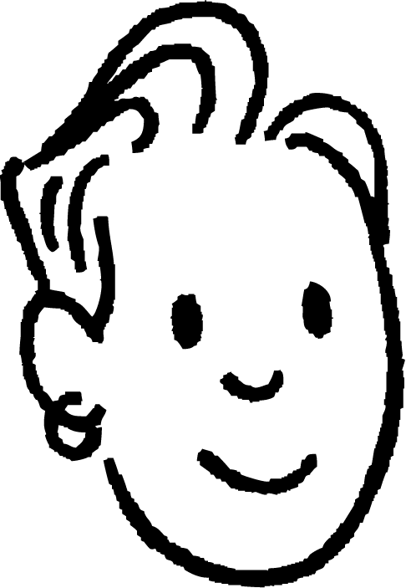
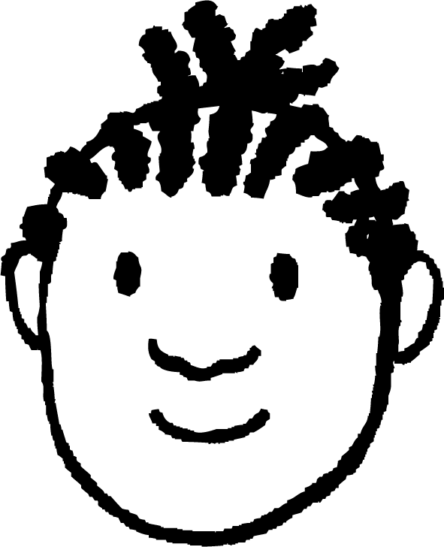



Finding a mode
Data are being collected about months of birth.
Aisha
Sam
Jacob
Lucas
Laura
Alex
January
May
December
September
April
July
Which month is the most common?
There isn’t a repeated month.
There still isn’t a repeated month. The sample is relatively small so no repeats is fairly likely. The data have no mode.

Slide 14
Finding a mode
When analysing data we might look for the most common piece of data, this is the measure of central tendency called the mode.
Smaller data sets may not have a mode.
The mode can be used on qualitative data, such as months, colours, animals etc.

Slide 15
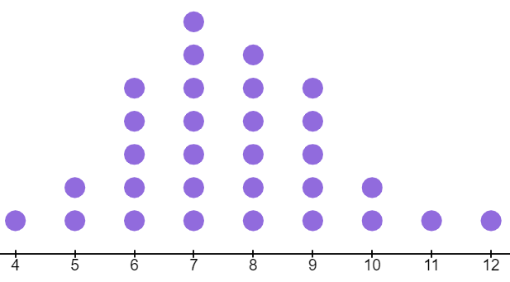
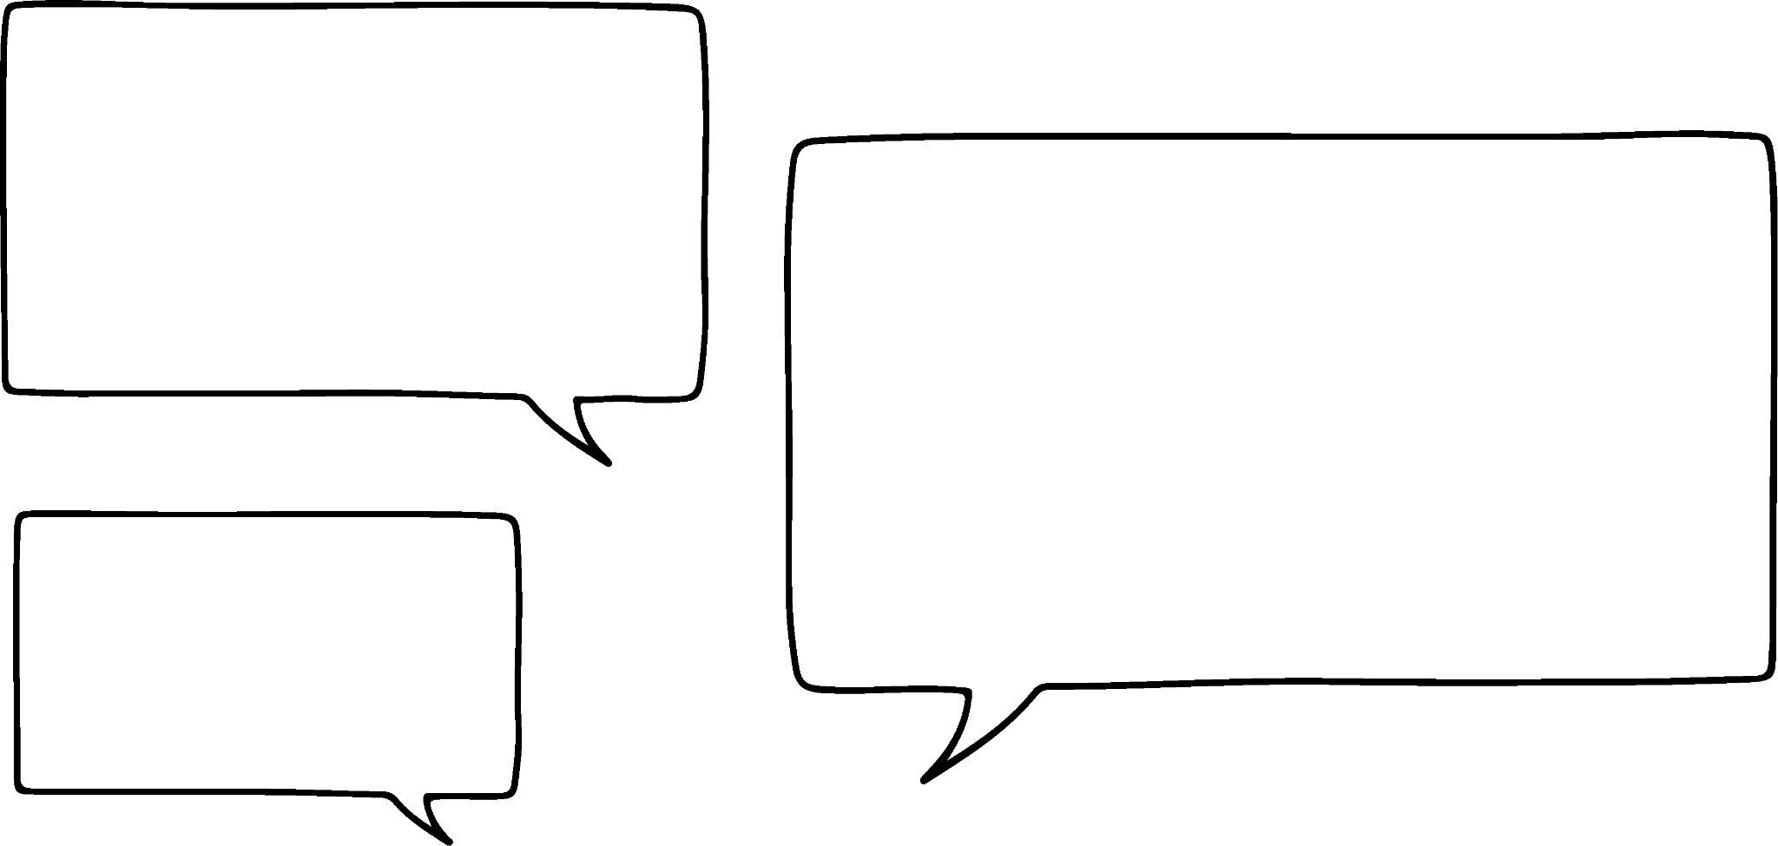
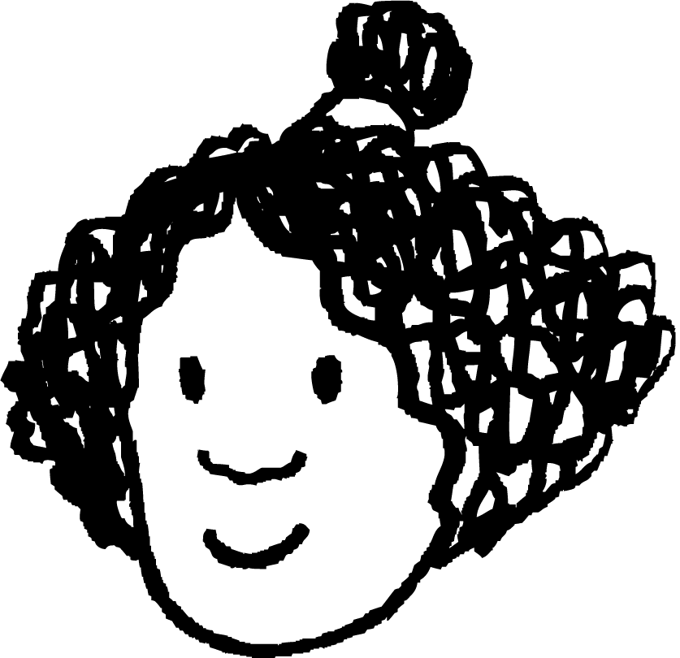
Finding a mode
Data is collected about shoe sizes in a class.
The most common shoe size is size 7.
But size 6 and size 9 both have 5 dots, so 5 is the most common.
shoe size
Izzy

Slide 16
Finding a mode
Data is collected about shoe sizes in a class.
The most common shoe size is size 7.
Izzy has commented on the most common frequency not the most common shoe size.
shoe size

Slide 17
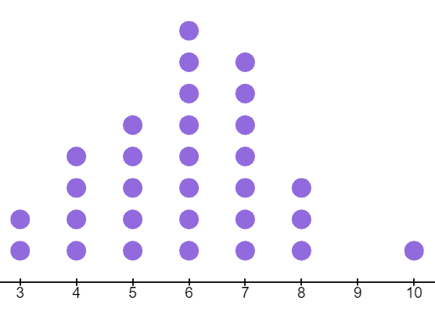
Finding a mode
In a year 8 class, data is collected about shoe sizes.
What is the modal shoe size in this year 8 class?
The modal shoe size is 6.
shoe size

Slide 18
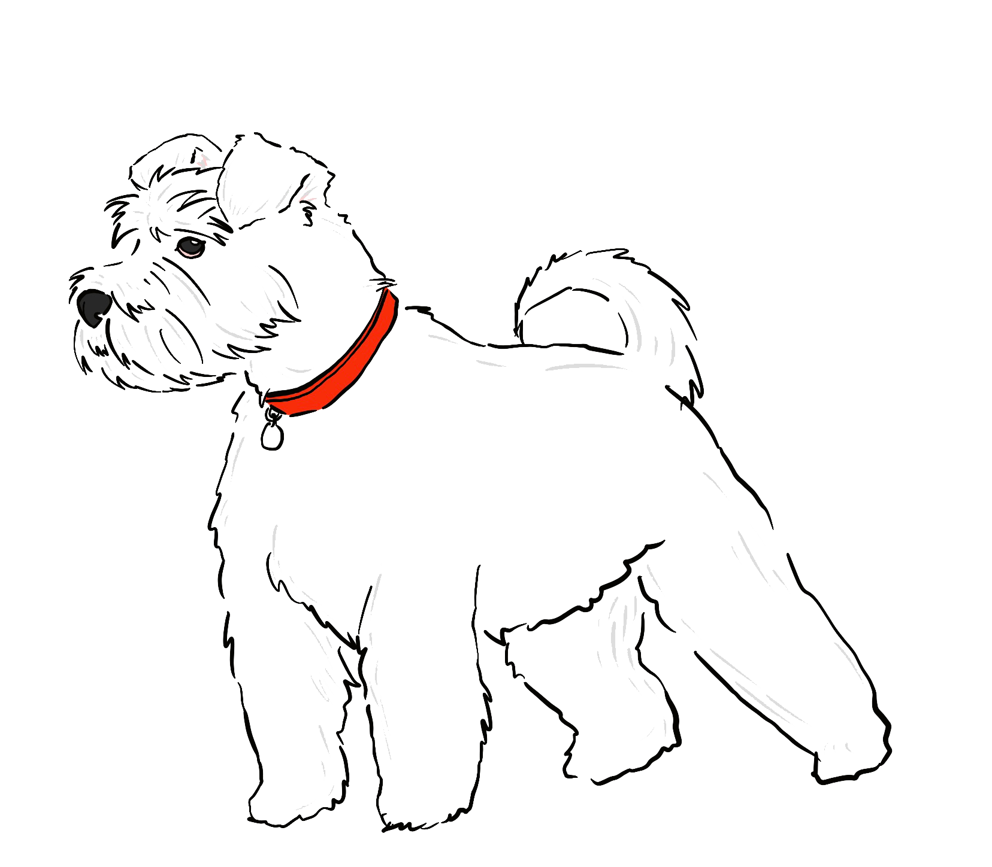
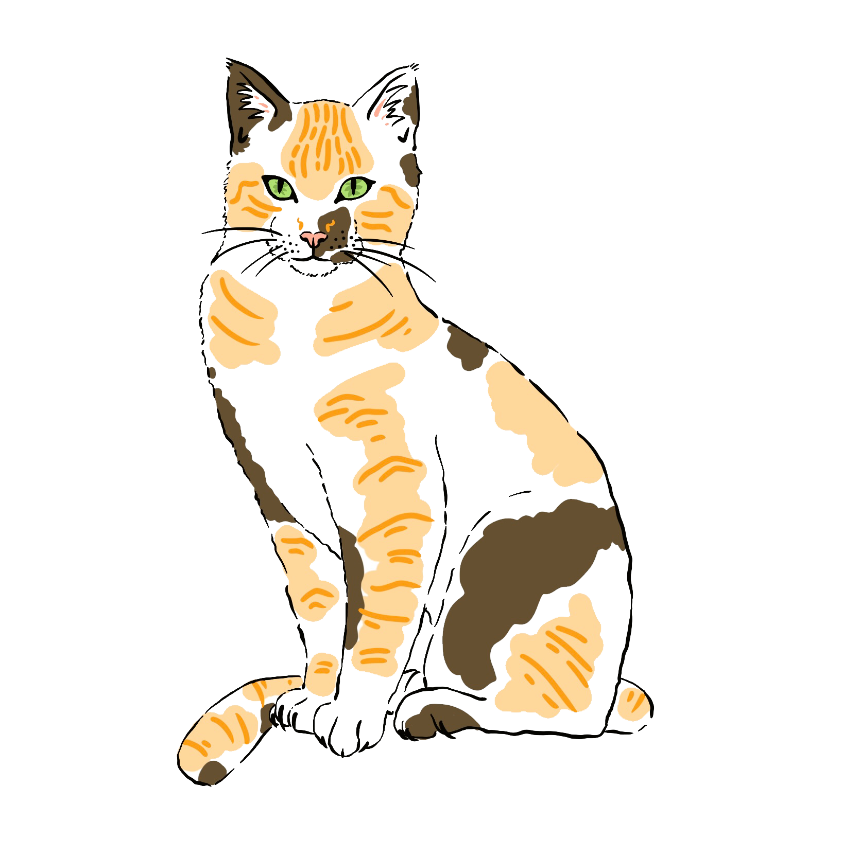
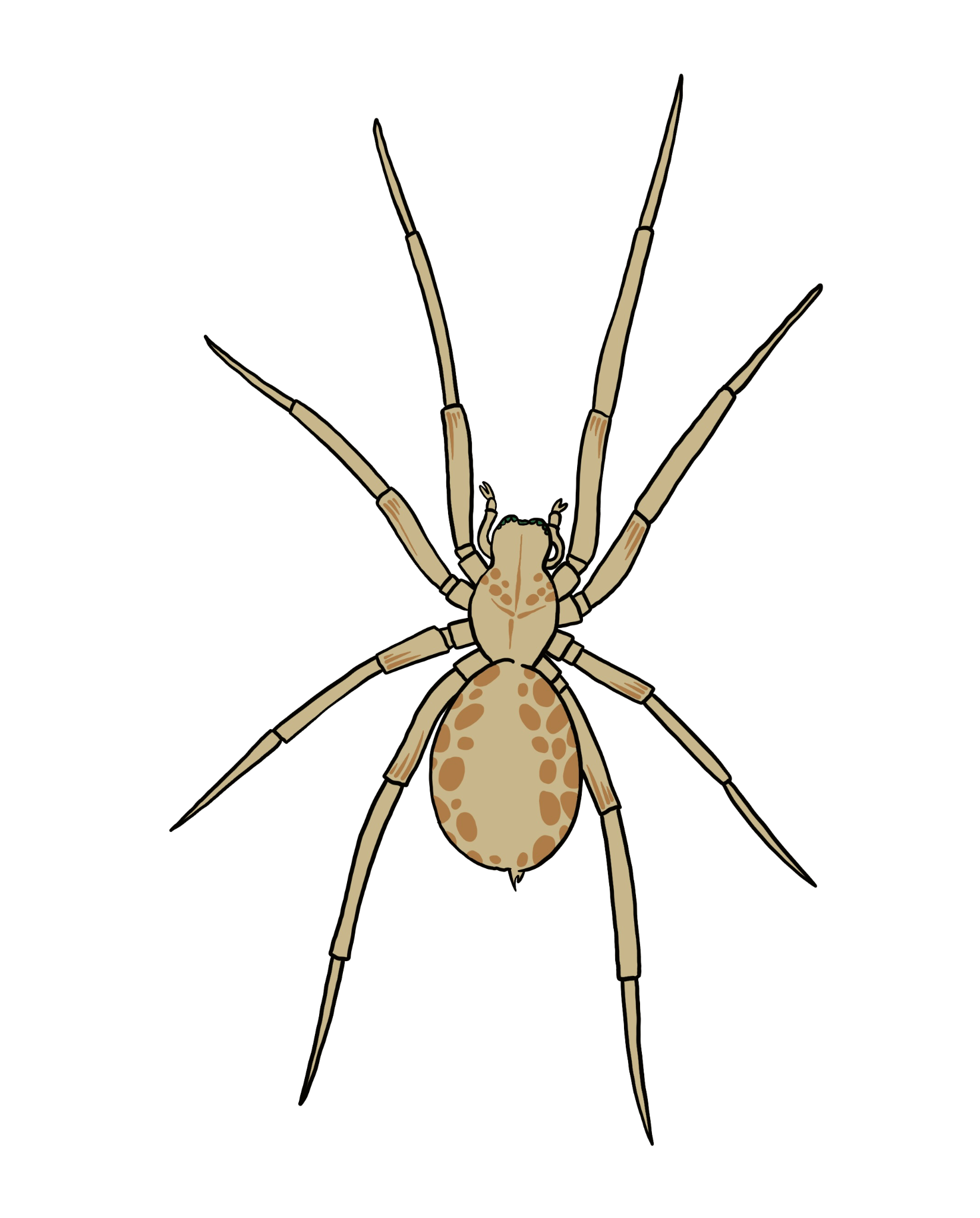

Finding a mode
1) What is the modal animal?
2) In this set of data, what is the mode? 0, 0, 0, 0, 0, 1, 1, 1, 1, 1, 1, 2, 2, 2, 3, 3, 3, 3, 3, 4, 4, 5, 5, 5, 5
3) In this set of data, what is the mode? 12, 16, 18, 12, 19, 18, 15, 16, 18, 19, 12, 12, 18, 15, 18

Slide 19
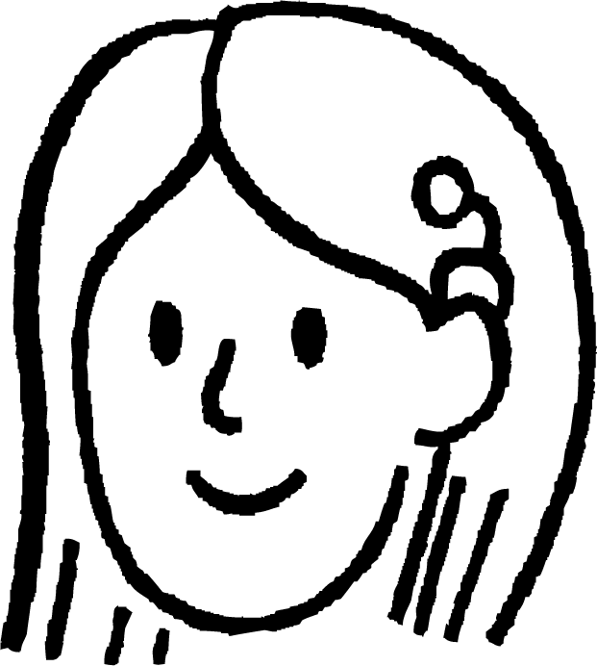
Finding a mode
4) Sofia was rolling an eight-sided dice.
What was the mode score on a roll on the dice?
I rolled a 6 ten times; I rolled a 7 twelve times; I rolled an 8 ten times.

Slide 20
Finding a mode
What is the modal animal?
The spider as it appeared 4 times compared to 3 beetles, 3 cats and 2 dogs.

Slide 21
Finding a mode
In this set of data, what is the mode? 0, 0, 0, 0, 0, 1, 1, 1, 1, 1, 1, 2, 2, 2, 3, 3, 3, 3, 3, 4, 4, 5, 5, 5, 5
1 is the mode, it appears 6 times which is the most occurrence compared to the other data.
In this set of data, what is the mode? 12, 16, 18, 12, 19, 18, 15, 16, 18, 19, 12, 12, 18, 15, 18
Ordering the data, shows the repeats more clearly:
12, 12, 12, 12, 15, 15, 16, 16, 18, 18, 18, 18, 18, 19, 19
The mode is 18.

Slide 22
Finding a mode
Sofia was rolling an eight-sided dice. What was the mode roll on the dice?
I rolled a 6 ten times; I rolled a 7 twelve times; I rolled an 8 ten times.
7 is the mode roll. It occurred 12 times compared to 10 times of each 6 and 8.

Slide 23
Understanding the mode
Finding a mode
It is not always one mode

Slide 24
It is not always one mode
We have seen that small data sets may not have a mode.
Larger data sets are more likely to have a mode.
This data contains 52 points and there is one mode.

Slide 25
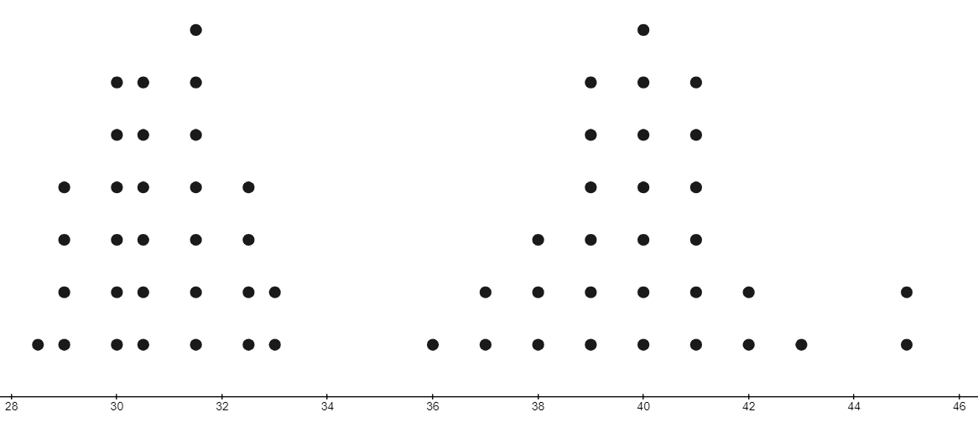
It is not always one mode
This dot plot shows the european shoe sizes of a group of pupils.
7 is the highest frequency.
The modal shoe size is 31.5 and 40.
This data is said to bimodal.
28
30
32
34
36
38
40
42
44
46
European shoe size

Slide 26
It is not always one mode
This dot plot shows the european shoe sizes of a group of pupils.
The data seems to have two subgroups.
A
B
Why might this be?
Subgroup A may be a younger class and subgroup B may be an older class within a school.
28
30
32
34
36
38
40
42
44
46
European shoe size

Slide 27
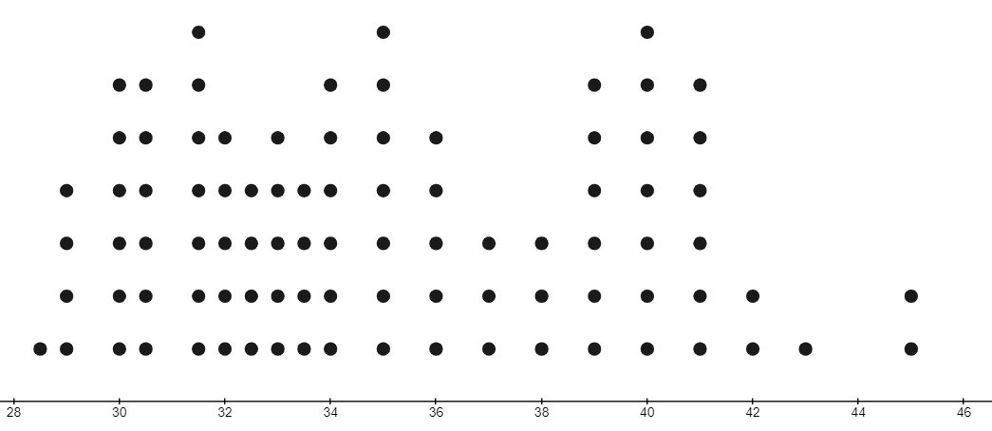
It is not always one mode
More pupils are asked about their shoe size.
Now the data is trimodal.
The modal shoe sizes are 31.5, 35 and 40.
28
30
32
34
36
38
40
42
44
46
European shoe size

Slide 28

It is not always one mode
Data can only have one mode.
The data might not have any mode.
The data might have no mode, one mode, two or more modes.

Slide 29
It is not always one mode
Write a data set of 20 that is bimodal.
Write a data set of 10 that has no mode.
Write a data set of 20 that is trimodal.

Slide 30
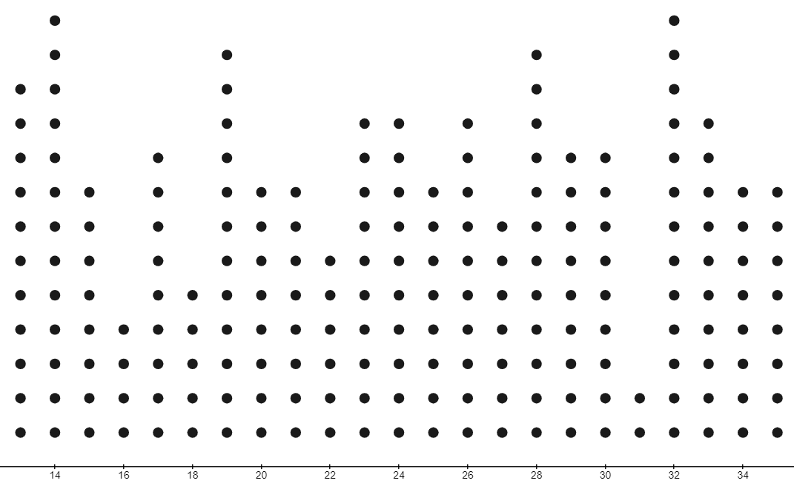
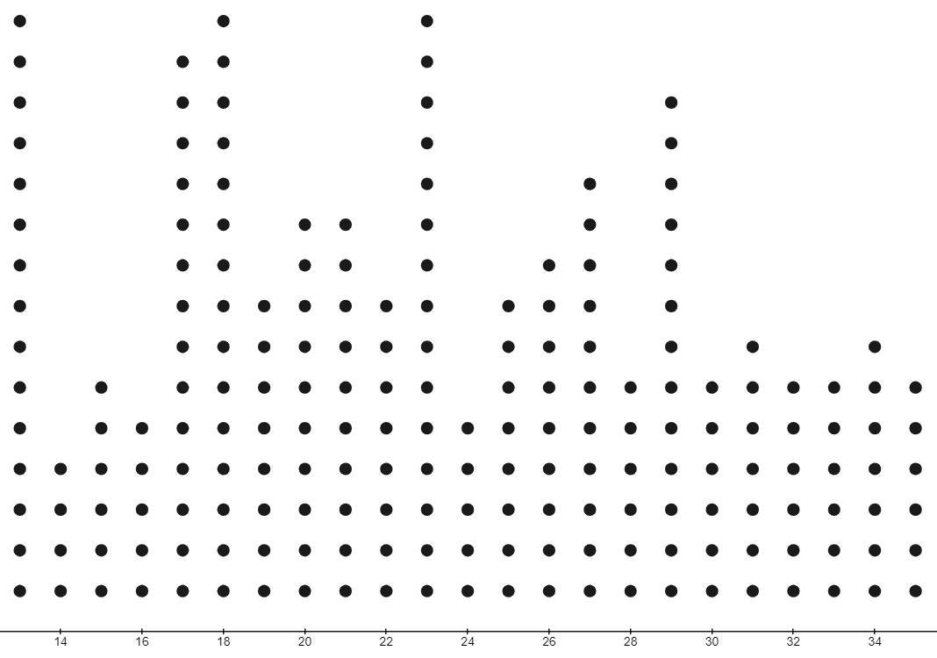
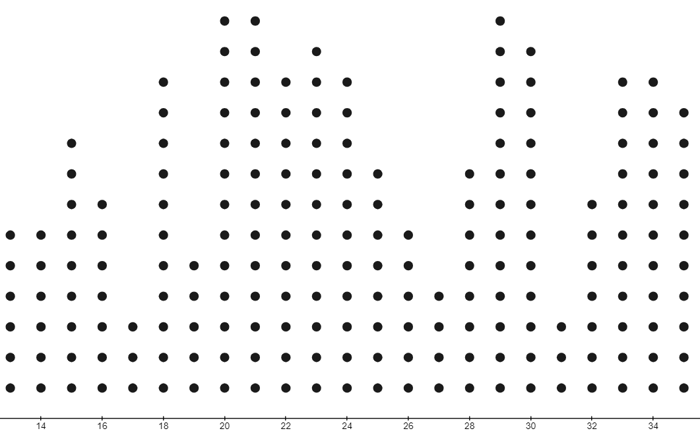
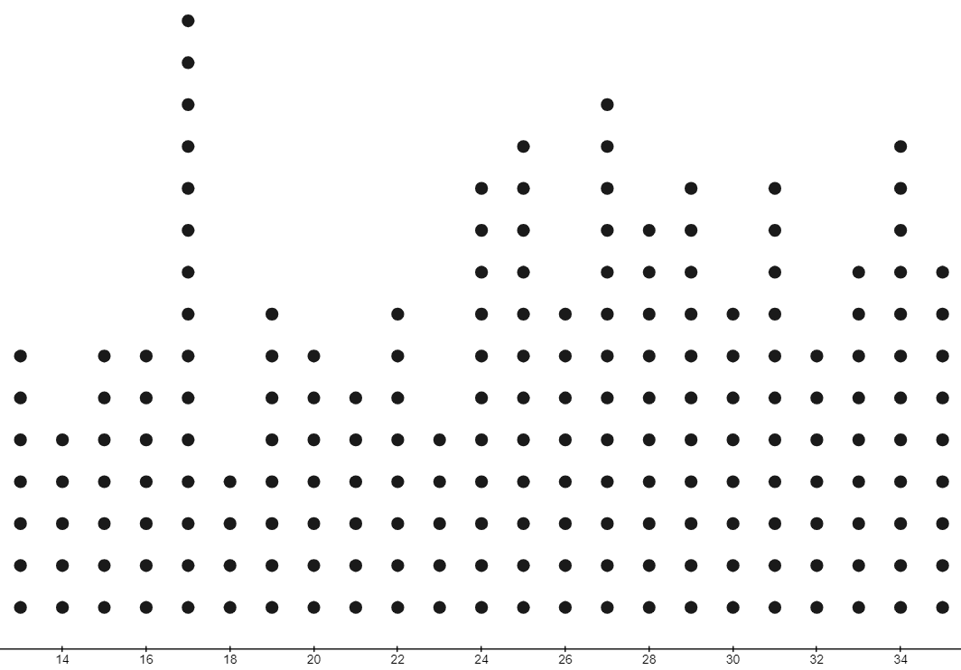
It is not always one mode
For each data set, write how many modes the data has, if any.

Slide 31
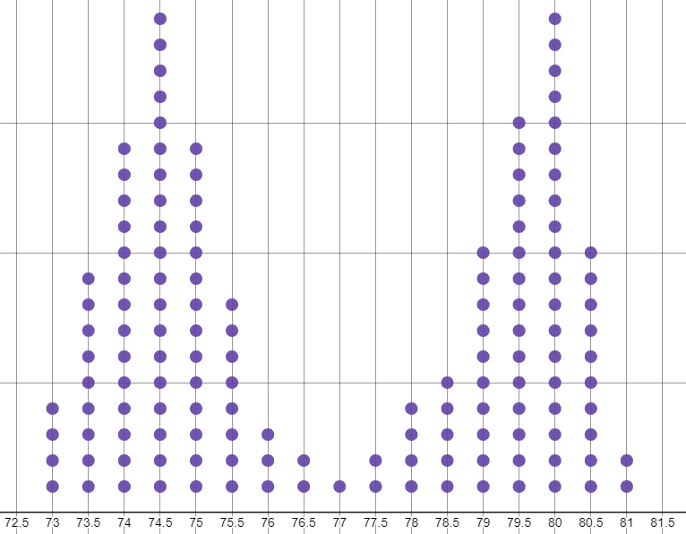
It is not always one mode
What is the mode of the data shown on this dot plot?

Slide 32
It is not always one mode
1) Write a data set of 20, that is bimodal.
2) Write a data set of 10, that has no mode.
3) Write a data set of 20, that is trimodal.
There are multiple correct answers for this. Two values should be repeated the same number of times as each other.
For example: 0, 0, 0, 1, 1, 2, 2, 3, 3, 3, 4, 4, 4, 4, 5, 5, 5, 5, 6, 6
There are multiple correct answers for this. Nothing should occur more than anything else.
For example: pink, white, red, blue, green, orange, brown, yellow, purple, teal
There are multiple correct answers for this. Three values should be repeated the same amount as each other.
For example: 0, 0, 1, 1, 2, 2, 3, 3, 3, 3, 4, 4, 4, 4, 5, 5, 5, 5, 6, 6

Slide 33
It is not always one mode
For each data set, write how many modes the data has, if any.
bimodal - 2 modes
trimodal - 3 modes
trimodal - 3 modes
1 mode

Slide 34
It is not always one mode
What is the mode of the data shown on this dot plot?
The data is bimodal.
The modes are 74.5 and 80.

Slide 35
Understanding the mode
The mode is a measure of central tendency.
The mode is the most frequently occurring value/object in a data set.
The mode can be used for non-numerical data.
There can be more than one mode. Data can be bimodal or trimodal.

Slide 36

© Oak National Academy 2023.
Produced in partnership with Mathematics in Education and Industry.
Licensed on the Open Government Licence v3.0, except where otherwise stated. See Oak terms and conditions.

